Slide 1

Looking to the future!
Taking a serious look at the past, present & the future of tradeshow exhibiting.

Slide 2




Thank You to Our Sponsors:

Slide 3
Upcoming Events:
July: TBD
August 24: Bowling for RSMGC
September: Educational Seminar
October 13: RSMGC
November: Gladiator’s Game
December 14: MedShare Charity Event

Slide 4
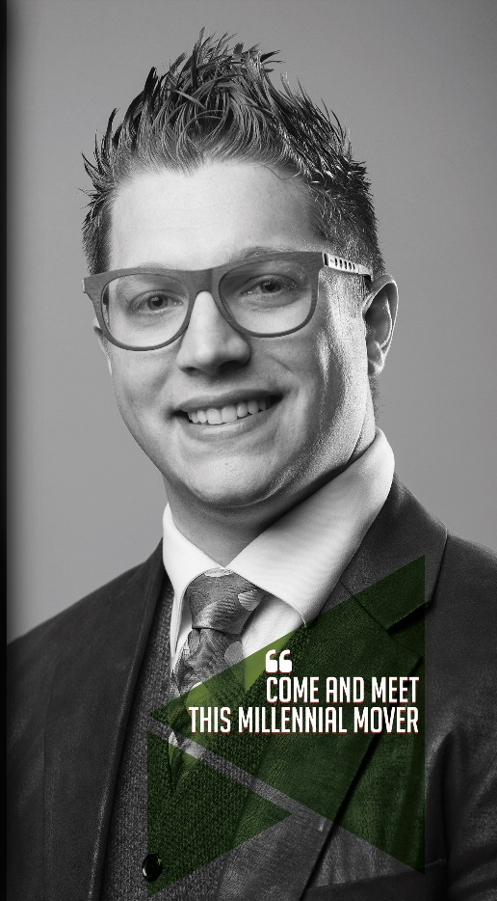
Today’s Speaker . . .
Dr. Sachel Josefson, Exhibit Design Professor in Bemidji State University's School of Technology, Art & Design

